Slide 2

University College Dublin

Slide 3
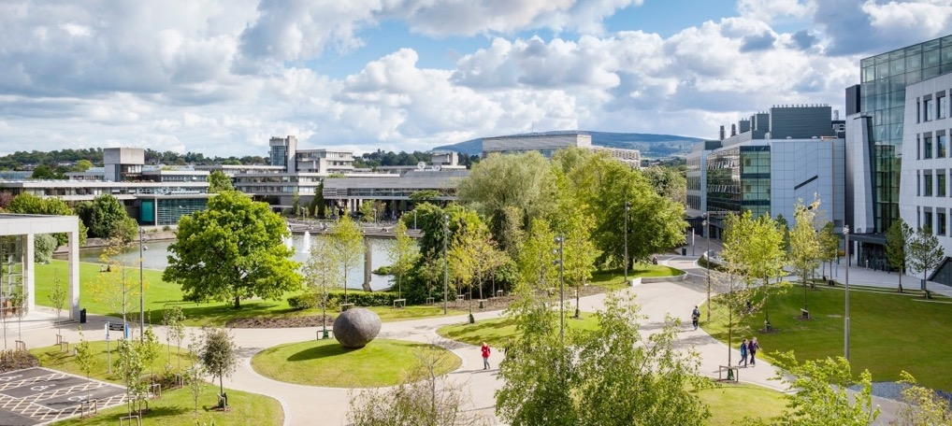
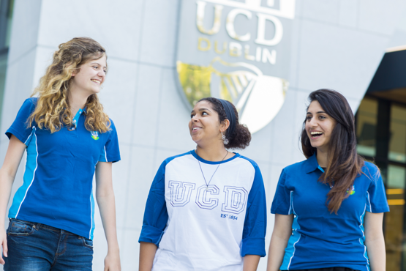




About UCD
University College Dublin
Ireland

Slide 4
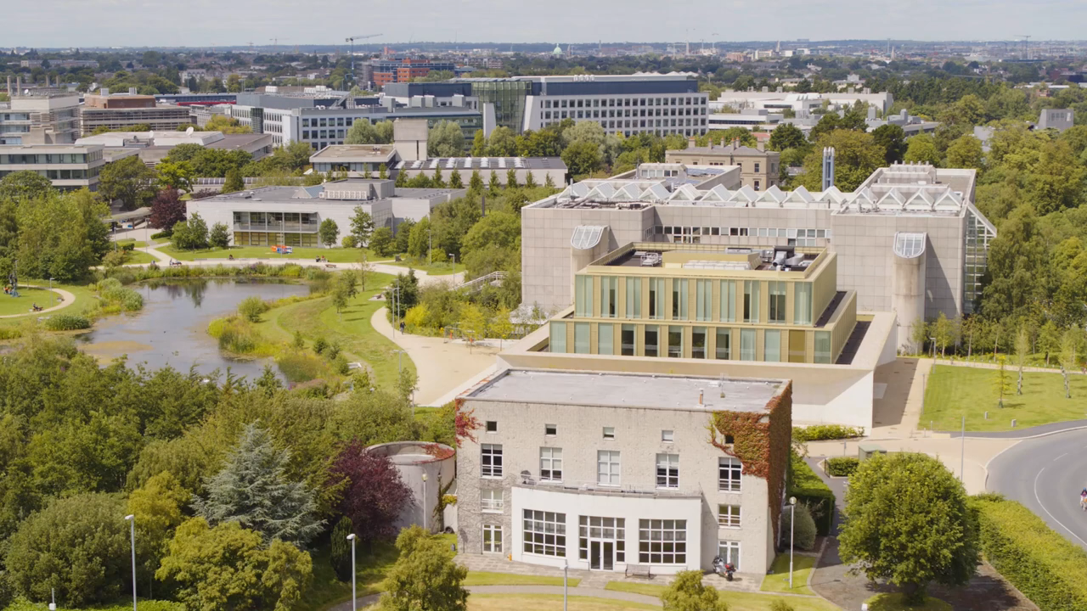

Slide 5




Slide 6
UCD School of Nursing, Midwifery and Health Systems

Slide 7

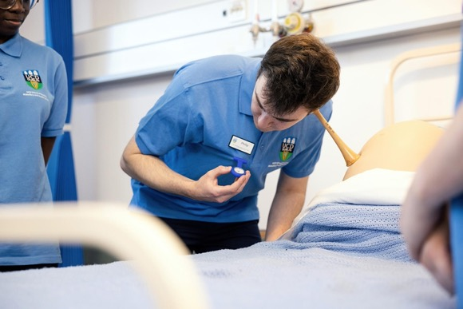


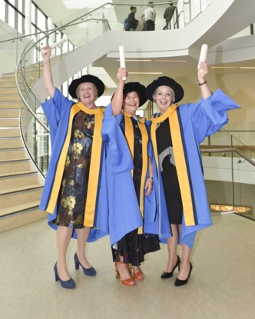
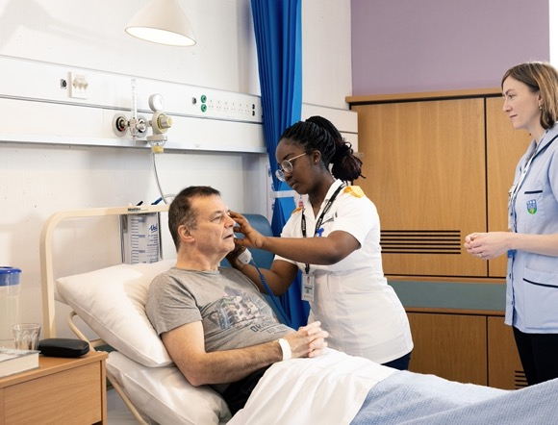
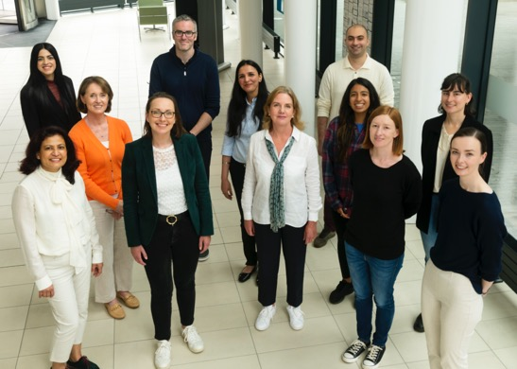
About Us

Slide 9
Our Values
Integrity
Collegiality
Creativity
Inclusion
Service
Scholarship

Slide 10


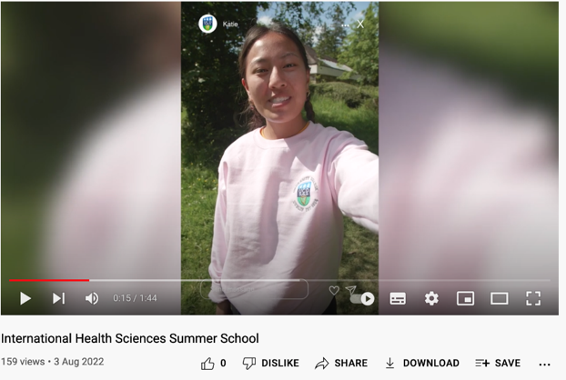



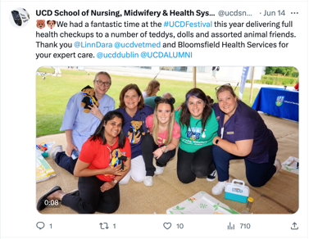




snmhs.official @ucdsnmhs

Slide 11
Our History

Slide 12


1960
The School was established as part of the department of medicine in UCD, Earlsfort Terrace.
1999
2002
2006
School of Nursing & Midwifery was established.
First BSc Nursing degree programme commences.
First BSc Midwifery programme commences
1984
2000
2005
The BNS (Nurse Tutors Degree) launched.
First Professor of Nursing in UCD.
We became the School
of Nursing, Midwifery
and Health Systems.

Slide 13
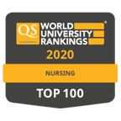
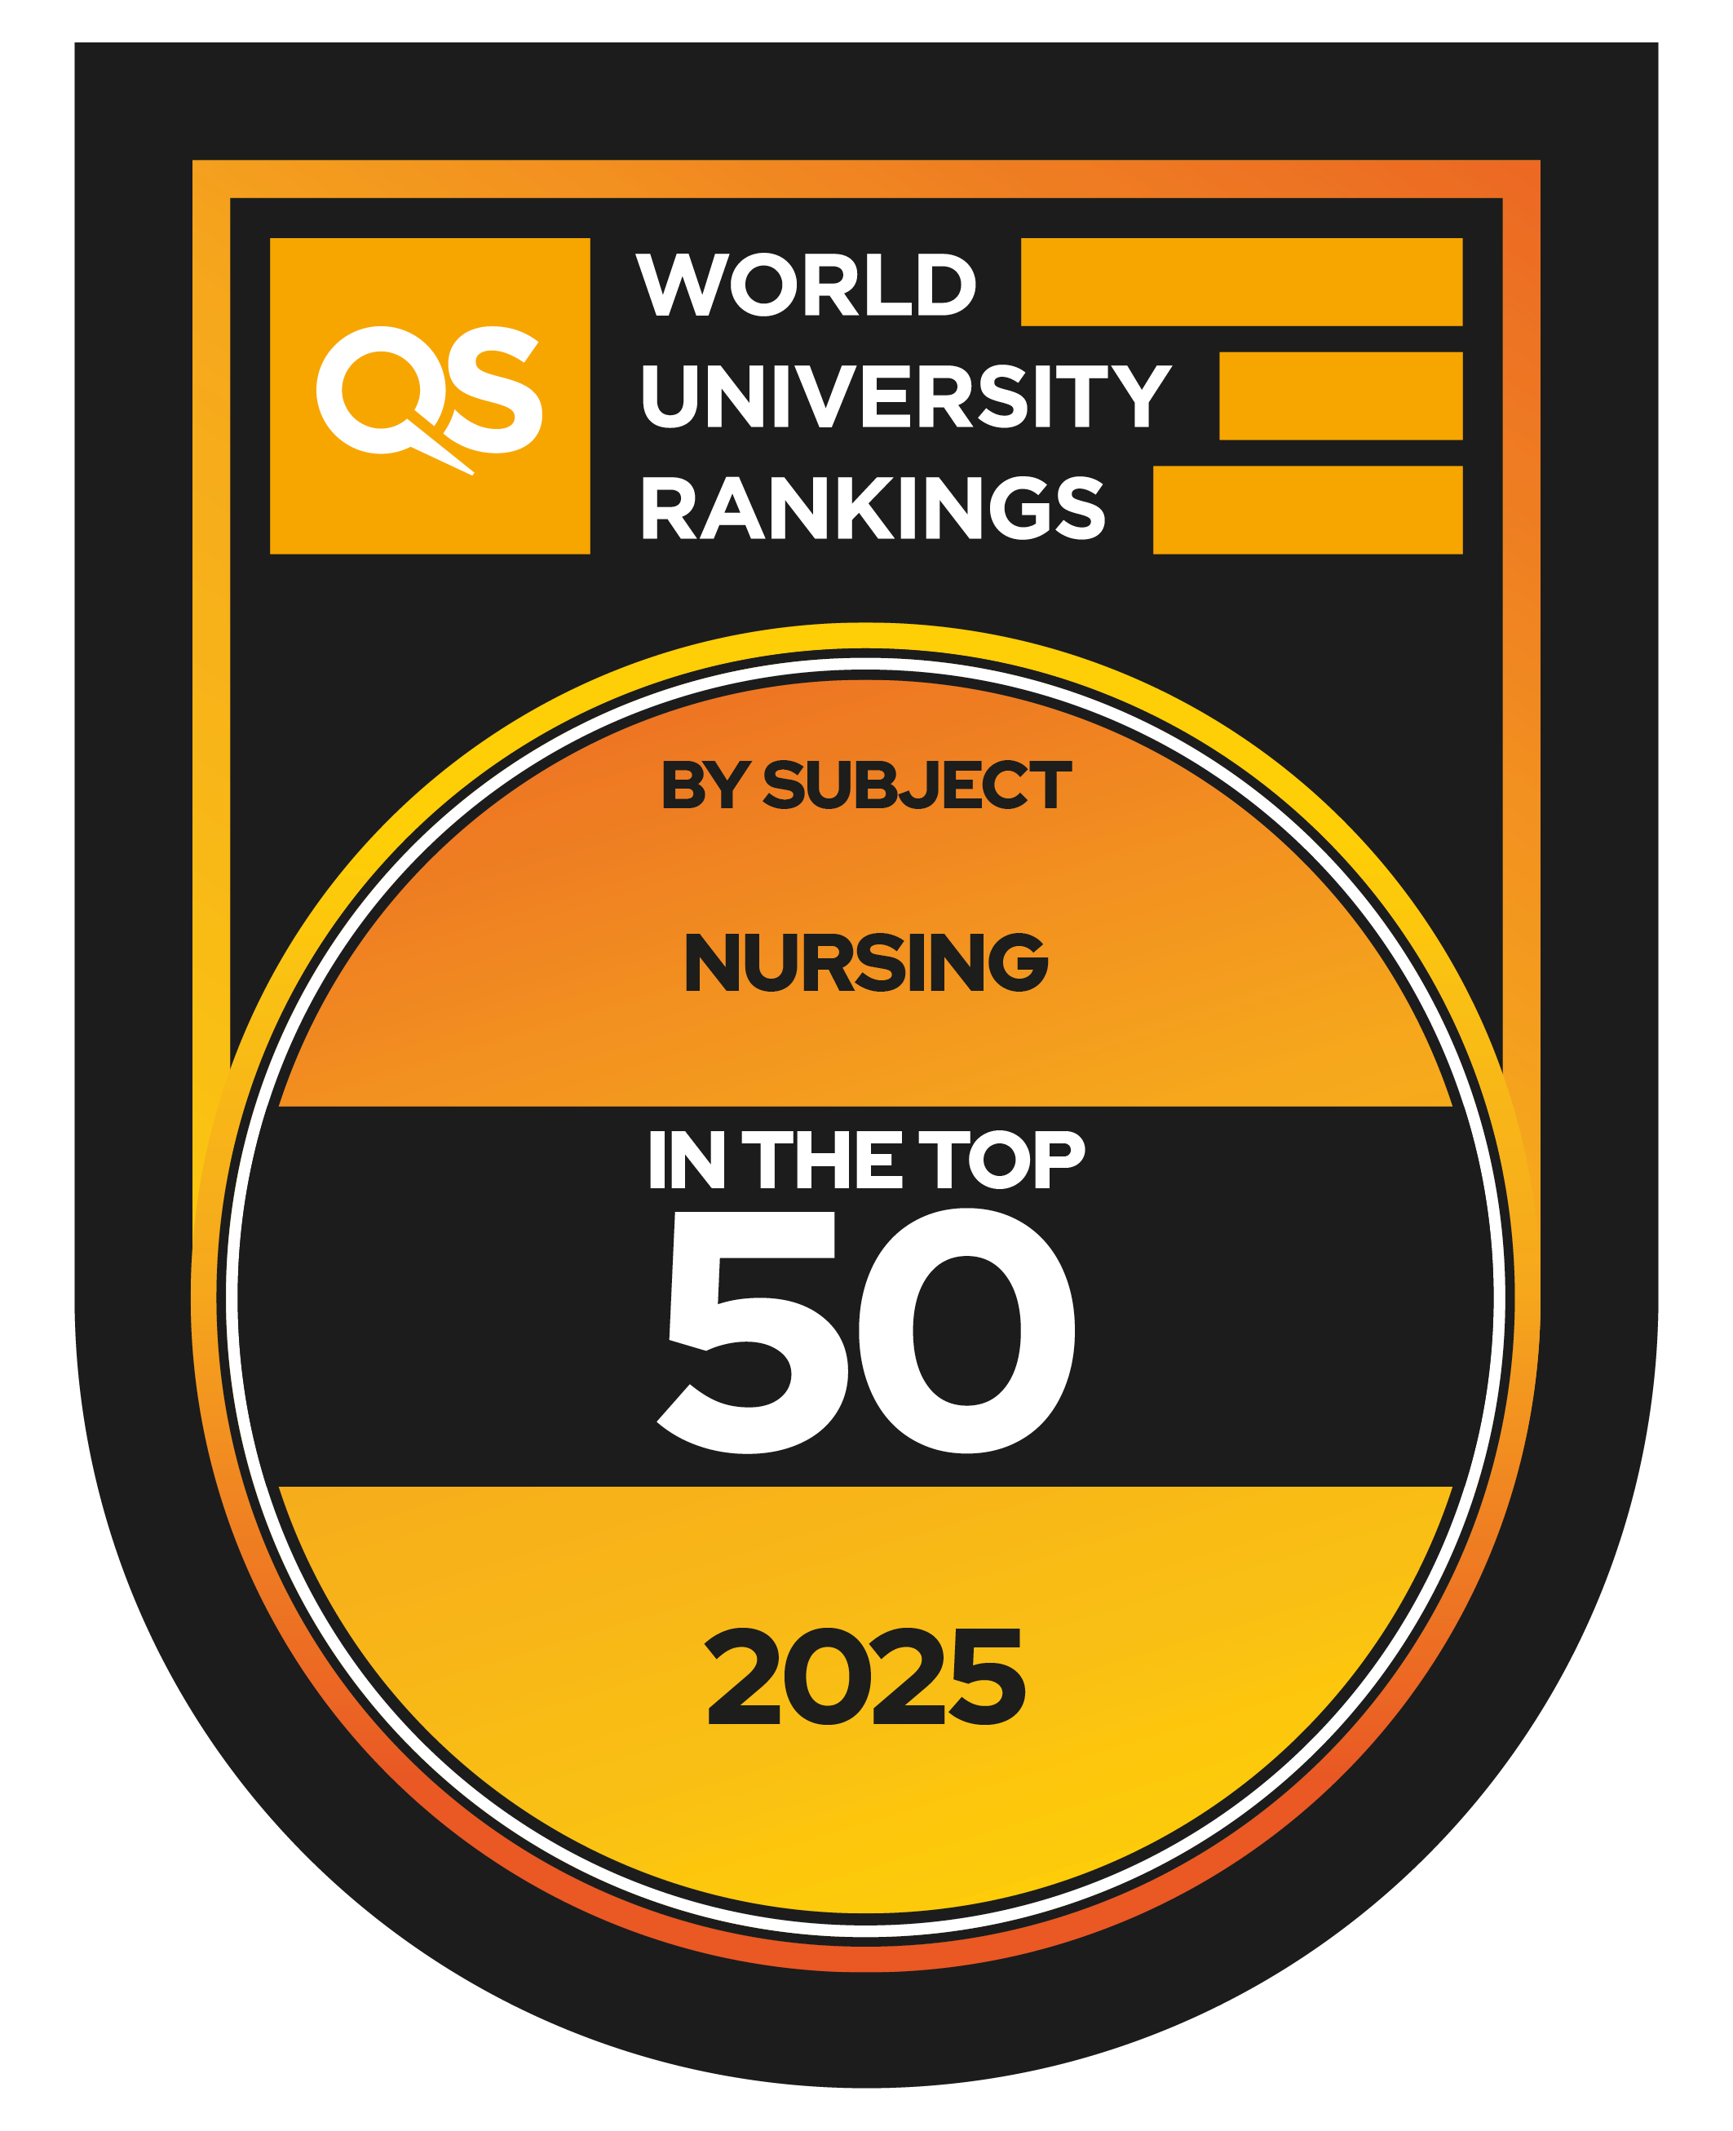

2009
First PhD graduates from UCD School of Nursing, Midwifery and Health Sciences.
2020
2025
In the top 100 QS World University ranking by subject.
2022
First Professor of Children’s Nursing in UCD
In the top 50 QS World University ranking by subject.
2016
2021
2023
College of Health and Agricultural Science established.
Awarded the Athena SWAN Bronze Award.
First Professor of Midwifery in UCD

Slide 14
Facts & Figures

Slide 15
Our Students
919
960
70
90
62
Undergraduate students
Taught Graduate students
Graduate Research students
Summer School students
Occasional students

Slide 16
Undergraduate Programmes
General Nursing
Children’s & General Nursing
Mental Health Nursing
Midwifery

Slide 17
CAO Points 2025
General Nursing
Mental Health Nursing
Children’s and General Nursing
Midwifery
444
400
510
511

Slide 18
Academic Entry Requirements
01
General Nursing
O6/H7 in English, Irish, Mathematics, a laboratory science subject and two other recognised subjects.
02
Mental Health Nursing
O6/H7 in English, Irish, Mathematics, a laboratory science subject and two other recognised subjects.
03
Children’s & General Nursing
O6/H7 in English, Irish, Mathematics, a laboratory science subject and two other recognised subjects.
04
Midwifery
O6/H7 in English, Irish, Mathematics, a laboratory science subject and two other recognised subjects.

Slide 19
Taught Graduate Programmes
Over 50 taught graduate programmes in the following areas…
Acute & Critical Care
Advanced Practice Nursing
Advanced Health Assessment
Cancer Nursing
Children’s Nursing
Chronic Care
Gerontological Nursing
Health Professions Education
Leading, Innovating and Managing
Mental Health
Midwifery
Palliative Care
Prescribing Medicinal Products
Public Health & Community Nursing
Radiology & Imaging
CPD

Slide 20
Research Programmes
The degree of Doctor of Philosophy (Ph.D.) is offered through a structured programme of rigorous training in research and offers students an opportunity to undertake a focused and critical examination of a particular topic with the aim of contributing to the development of knowledge in their field.
Doctoral (Ph.D.) Degree
Level 10
The Masters (MSc) Research degree provides students with rigorous research training and an opportunity to complete an independent research study, presented as a major thesis.
Masters (MSc) Degree
Level 9

Slide 21






Our Clinical Partners
The School is partnered with the Ireland East Hospital Group, along with a number of other hospitals and community-based practices. Below is a small selection of the 80+ sites where students can obtain a placement while studying at UCD.

Slide 22
Our People
62 faculty
17 research staff
22 support staff
83% female/
17% male

Slide 23






Student Support
Academic Supports Library, writing centre, maths support… | Student Advisors Offer assistance when personal, financial or social difficulties arise… | UCD All Committed to supporting access to Higher Education for all | Careers Network Join the dots between UCD and your future Career…
Chaplaincy Offers student support, pastoral care and spiritual direction… | Counsellors Psychological support to assist students with personal challenges | Student Desk Provides assistance to students with administrative needs and much more… | UCD EDI Supporting an inclusive and diverse university community for all
Healthy UCD Sleeping, eating, exercise, life hacks and all things healthy | Student Health On-campus medical, psychological and psychiatric care for UCD registered students… | UCD SU Your Union, You Voice | Societies & Clubs With over 70 student societies, UCD has something for everyone…

Slide 25
THANK YOU
Any questions?

